Slide 1
Quality. Processes. Results.

Slide 2
Company

Slide 3
QPR is a leading player in a Digital Twin of an Organization (DTO) use case and one of the most advanced companies in the world in process mining -software.

Slide 4
Mission
We innovate, develop and deliver software for analyzing, monitoring, and modeling organizations’ operations. In addition, we offer consultancy services to ensure customers get full value out of the software and related methods.
Purpose
Our purpose is to help organizations reach their full operational potential.
Strategic targets
We focus on growing our SaaS business internationally.
Targets:
SaaS growth +20% annually on average between 2024-2027
Sustainable profitability

Slide 5
Our offering
We are a leading player in Digital Twin of an Organization (DTO) use case and one of the most advanced companies in the world in process mining -software. QPR product portfolio consists of the following software:
QPR ProcessAnalyzer
Powerful process mining platform supporting all use cases and Powered by Snowflake
QPR Metrics
The leading strategy and performance management software with exceptional user experience
QPR EnterpriseArchitect
Enterprise modelling software enabling modelling and analysis of all different enterprise architecture dimensions
QPR ProcessDesigner
Easy to use enterprise level process modelling software with easy and attractive communication portal

Slide 6
Go-to-market strategy
Value proposition
Drive Business Impact with QPR DTO.
Enable Informed Decision-Making with Smart Data
Enhance Operational Efficiency and Reduce Costs
Elevate Customer Service Excellence
Proactively Manage risks
Business model
Direct sales
In-direct sales through reseller and co-selling partners
Geographical focus
Europe
Middle East
North America and other potential new market areas as new focus markets through partners
Target customers
Enterprise-level companies representing a wide variety of different verticals
Large public sector organizations
Existing Snowflake customers

Slide 7
QPR DTO Solution
Digital Transformation Management
Strategy and performance management
Program and project management
Identification of projects, transformation objectives and risks
Process KPIs
As-is processes
Improvement ideas
Enterprise modeling
Model everything from business models to application & technology portfolios
Process & enterprise mining
Discovery & analysis
Business rules & conformance, and notifications
Operational KPIs and dashboards
Data Cloud
Data storage
Data pipelines & transformation
To-be processes for conformance testing
Professional Services

Slide 8
QPR Software Plc Interim Report January-March 2024

Slide 9
January-March 2024 highlights
SaaS net sales increased by +15%
Software net sales increased by +4%
Net sales was 1,769 thousand euros, down -21% (January-March 2023: 2, 237) due to company’s discontinuation of consulting outside the core business.
EBITDA was 295 thousand euros (-36), a difference of 332 thousand euros from the comparison period
The operating profit was 33 thousand euros (-287), a difference 320 thousand euros from the comparison period
Profit before taxes was 13 thousand euros (-326), a difference 339 thousand euros from the comparison period
The result was 13 thousand euros (-331), a difference 344 thousand euros from the comparison period
Earnings/share was 0.001 euros (-0.027)
Cash flow from operations EUR -5 thousand (475)

Slide 10
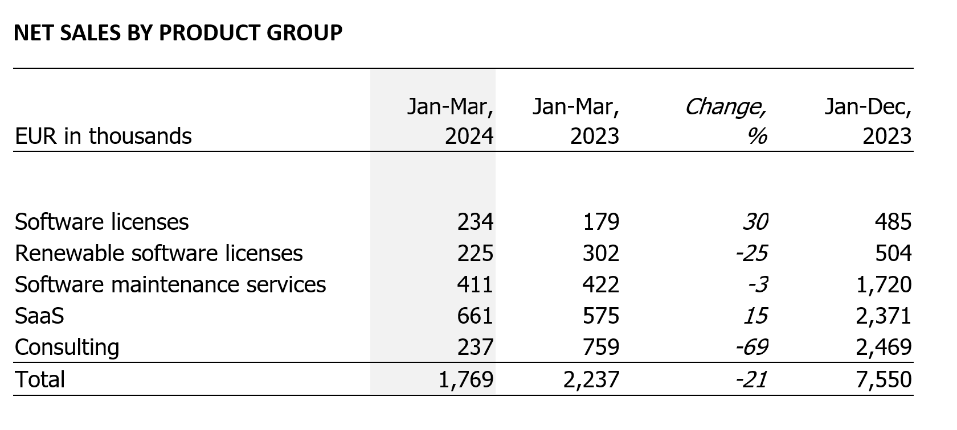
Net sales development

Slide 11
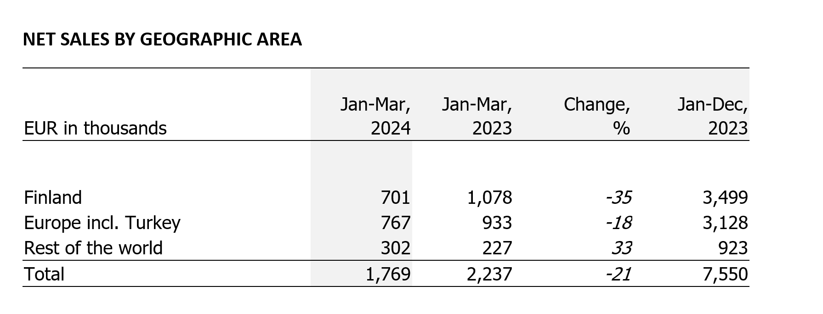
Net sales development

Slide 12
Profit & Loss January-March 2024
The Group Net Sales EUR 1,769, down -21% due to company’s discontinuation of consulting outside the core business. SaaS growth +15% and total SW net sales +4%.
The Group's variable expenses were 260 thousand euros (469), -45% due to closing fixed price Middle East projects.
The Group's fixed expenses were EUR 1,319, decrease -37%: due to due to the savings programs implemented in the second and last quarter of 2023, reducing personnel and other operating costs.
The Group's EBITDA 295k€ positive (-36k€), the operating result was -813k€ (-2,770) +71%
The result before taxes was –924€ and the result for the period was -924k€.
Earnings/share was 0.001 euros (-0.027)
EUR in thousands, unless otherwise indicated | Jan-Mar or Mar, 2024 | Jan-Mar or Mar, 2023 | Jan-Dec or Dec 31, 2023
Net sales | 1,769 | 2,237 | 7,550
Net sales growth, % | -20.9 | 1.6 | -3.5
EBITDA | 295 | -36 | 182
% of net sales | 16.7 | -1.6 | 2.4
Operating result | 32 | -287 | -813
% of net sales | 1.8 | -12.8 | -10.8
Result before tax | 13 | -326 | -924
% of net sales | 0.7 | -14.6 | -12.2
Result for the period | 13 | -331 | -924
% of net sales | 0.7 | -14.8 | -12.2
Return on equity (per annum), % | 14.1 | -410.2 | -221.5
Return on investment (per annum), % | 6.9 | -57.6 | -42.0
Cash and cash equivalents | 264 | 172 | 885
Net borrowings | 1,032 | 2,041 | 934
Equity | 374 | 159 | 348
Gearing, % | 276 | 1285 | 268
Equity ratio, % | 13.6 | 3.6 | 8.1
Total balance sheet | 4,845 | 5,853 | 5,869
Investments in non-current assets | 106 | 270 | 637
% of net sales | 6.0 | 12 | 8.4
Product development expenses | 332 | 510 | 1,427
% of net sales | 18.8 | 22.8 | 18.9
Average number of personnel | 39 | 67 | 57
Personnel at the beginning of period | 49 | 85 | 85
Personnel at the end of period | 35 | 65 | 49
Earnings per share, EUR (basic and diluted) | 0.001 | -0.017 | -0.055
Equity per share, EUR | 0.021 | 0.010 | 0.020

Slide 13
Finance and investments
The cash flow from operations for the period was negative 5 thousand euros (475). The main reason for this change compared to the comparable period was successful collection in the last quarter of 2023, particularly regarding the advanced license payments for 2024. A greater portion of the advance payments was collected in the last quarter of 2023, leading to a lower cash flow from annual licenses in the first quarter of 2024.
The investments were 105 thousand euros (275), and they were research & development investments.
The Net financing cash flow was –512 thousand euros, primarely due to 500,000 euros amortization to the bank loan according to terms.
The group's financial position is fair. At the end of the review period, the group's cash and cash equivalents were 264 thousand euros (172) and short-term receivables were 1,460 thousand (1,685).
The group has available unused credit limit of 500,000 euros.
At the end of the review period, the group had a bank loan of EUR 1,500 thousand, of which EUR 1,000 thousand was long-term.
Covenants are attached to the loan, which are based on the company's EBITDA and equity ratio. EBITDA will be tested half yearly and equity ratio at the end of year.

Slide 14
Outlook for 2024 (unchanged)
The company monitors the development of the world's economic situation and geopolitical tensions. The slowly budding recovery of economic growth, falling interest rates and normalizing inflation will improve the financial position of customers, and investment decisions can be expected to accelerate towards the end of 2024.
Supported by the current contract base and the projected growth of SaaS (Software as a Service) net sales, QPR expects the growth of SaaS net sales to be double-digit and estimates that the entire software net sales will grow in 2024 (2023: 5,122 thousand euros).
The company expects the operating result to improve significantly in the financial year 2024. The operating result in 2023 was -813 thousand euros.

